Slide 1
Data Analytics
陈宇翔 chenyux@cn.ibm.com IBM 架构师

Slide 2


Course
DeepLearning.AI Course
https://www.deeplearning.ai/specializations/data-analytics
+

Slide 3
Resource
Community (Lecture Notes)
Course 1 https://community.deeplearning.ai/t/data-analytics-course-1-lecture-notes/788732
Course 2 https://community.deeplearning.ai/t/data-analytics-course-2-lecture-notes/788733
Course 3 https://community.deeplearning.ai/t/data-analytics-course-3-lecture-notes/804543
Course 4 https://community.deeplearning.ai/t/data-analytics-course-4-lecture-notes/819464
Course 5 https://community.deeplearning.ai/t/data-analytics-course-5-lecture-notes/838617

Slide 4
Course 1
Data Analytics Foundations

Slide 5
Resources
What is data analytics?
A Guide to Sabermetric Research - This website highlights advanced baseball statistics, a field revolutionized by Bill James's pioneering work in sabermetrics. His approach popularized modern data analytics in sports, illustrating the broader application of data-driven decision-making across various fields.
Operations Research in World War II - Describes early applications of operations research such as optimizing radar placement to protect Britain from air raids. This laid the groundwork for modern data analytics.
Product Peas (Medium). Case Study 2— Zach Schendel, Director of UX Research at Netflix - The author here summarizes a webinar from Netflix discussing one method to enhance their users' content discovery. By conducting eye-tracking studies, Netflix optimized the bottom third of the screen, leading to significant increases in user engagement through tailored images based on viewing history.
Nielsen method for TV ratings missing minorities, young people - This article discusses how Nielsen's TV ratings method fails to accurately represent minority and younger viewers, leading to skewed data in audience measurement.
The Data River – How Data Flows Through the HelloFresh Production Process - Provides a high-level overview of how data is consumed by HelloFresh to power their business decision-making.
How we are using Hotjar to improve our web pages - The article details how the University of St. Andrew's has been using heatmap data to gain insights into web page interactions and improve user experience.
What is data?
How Many Orders Does Amazon Get & Deliver per Day? - The article details the staggering volume of Amazon orders, revealing that the platform processes millions of orders per day. This immense data volume underscores the scale at which Amazon operates and the complex data management and analytics required to handle such a high transaction rate.
How Much Data Is Generated Every Minute On Social Media? - Similar to the article above, this one describes the huge amount of data found in various social media platforms.
Large language models for data analytics
DeepLearning.AI has courses dedicated to generative AI and large language models (LLMs), and we've selected a few videos from them to complement the discussions in class. Take note that you don't need to take the entirety of these other courses. These few videos are enough to get you more acquainted with LLMs:
Generative AI & LLMs - This video is a concise introduction on large language models (LLMs), their use cases, and how they generate text by identifying patterns in vast datasets.
LLMs as a thought partner - This video also explores practical uses of LLMs, from answering factual questions to generating creative content. It highlights how these models can complement web searches and serve as thought partners for brainstorming and creative tasks.
What LLMs can and cannot do - This video provides an overview of the capabilities and limitations of LLMs. It highlights key limitations such as knowledge cutoffs and hallucinations, emphasizing the need for careful use and verification of LLM-generated content.

Slide 6
Module 1
Data and the data analyst role

Slide 7
Module 2
Using spreadsheets for data analytics

Slide 8
Dataset
Hotel Reservations Dataset https://www.kaggle.com/datasets/ahsan81/hotel-reservations-classification-dataset

Slide 9
Module 3
Data visualization in spreadsheets

Slide 10
Resources
Data storytelling
The Underappreciated Man Behind the "Best Graphic Ever Produced" - This article highlights Charles Minard's pioneering work in cartography and infographics, notably his famous visualization of Napoleon's Russian campaign. Minard's techniques, such as integrating multiple data dimensions into a single chart, laid foundational principles for modern data visualization and storytelling.
Disintermediating your friends: How online dating in the United States displaces other ways of meeting - This article shows the chart and insights from the data gathered regarding how couples meet in the US.
scores of scatterplots! - This shows how several people used scatterplots to visualize data that they find interesting.
Creating charts
Types of charts & graphs in Google Sheets - You can learn more about other charts not discussed in class here.

Slide 11
Module 4
The data analytics lifecycle

Slide 12
Course 2
Applied Statistics for Data Analytics

Slide 13
Module 1
Foundational statistical techniques

Slide 14
Statistical sampling methods
Probabilistic 概率采样
Simple random sampling 平均采样
Systematic sampling 系统采样
先定一个随机数，每隔一段采样
原先数据的排布，有可能会影响采样结果
Stratified sampling 分层采样
先把数据分组（strata），每组中随机采样
年龄、性别、教育水平、地区、种类、价格…
Cluster sampling 分群采样
数据分群（cluster），分别随机采样（与上类似）
分群方法，有可能会影响采样结果
Non-probabilistic 非概率采样
Convenience sampling 方便性原则采样
怎么方便怎么来
容易引入 bias
Quota sampling 配额采样
分组，每组给一定比例配额，组中随机抽样
分组方法，配额比例都会引入 bias
Judgment sampling 判断采样
先判断抽取对象（如：职业=教授、记者…），再随机抽样
判断方法和结果，会引入 bias
Snow sampling 雪球采样
先少量采样，由它们推荐更多的采样点
初始样本点，样本空间的网络结构会影响采样结果

Slide 15
Bias
Sampling bias
Measurement bias
Response bias
Analysis bias

Slide 16
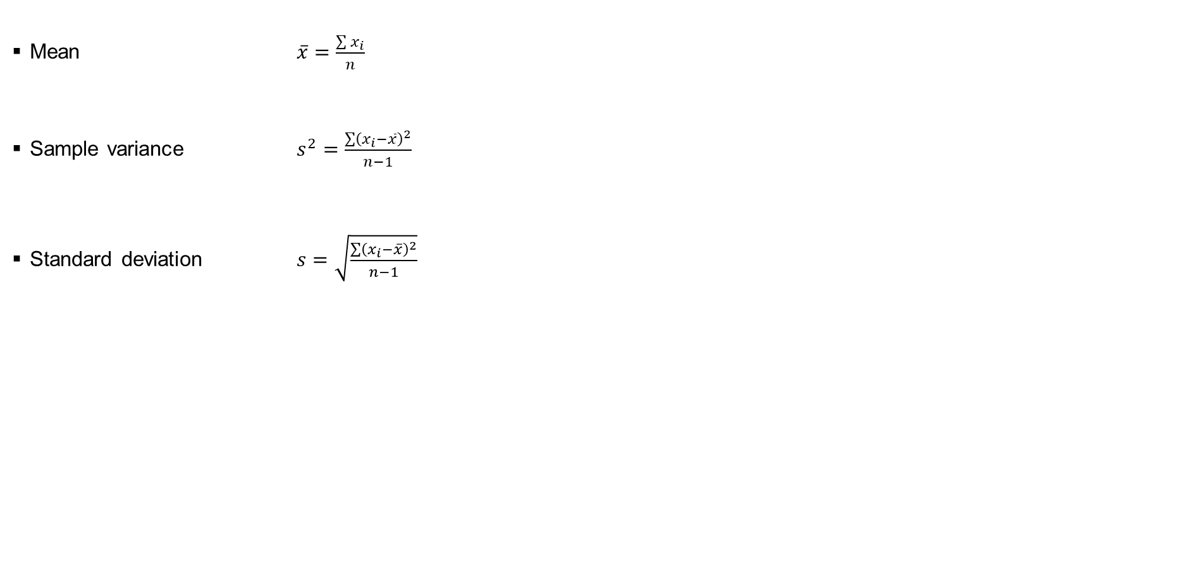
Formula
Mean $\overline{x}=\frac{\sum{x_{i}}}{n}$
Sample variance $s^{2}=\frac{\sum{{\left(x_{i}−\overline{x}\right)}^{2}}}{n−1}$
Standard deviation $s=\sqrt{\frac{\sum{{\left(x_{i}−\overline{x}\right)}^{2}}}{n−1}}$

Slide 17
Excel macro
=MAX(Data!Q:Q)
=MIN(Data!Q:Q)
=AVERAGE(Data!Q:Q)
=MEDIAN(Data!Q:Q)
=PERCENTILE(Data!Q:Q, 0.1)
=PERCENTILE(Data!Q:Q, 0.5)
=PERCENTILE(Data!Q:Q, 0.95)
=VAR(Data!Q:Q)
=STDEV(Data!Q:Q)
=SKEW(Data!Q:Q) # minimal: 0<|stew|<0.5, moderate: 0.5<|stew|<1, high: |stew|>1
=CORREL(Data!Q:Q,Data!N:N)
=xlookup(A2:A, sheet1!A:A, sheet1!B:B) # lookup_value, lookup_array, return_array

Slide 18
Module 2
Probability and simulation

Slide 19
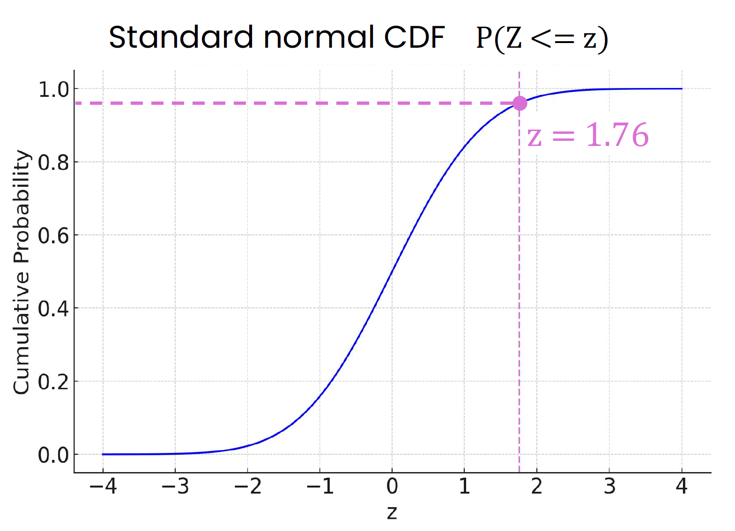
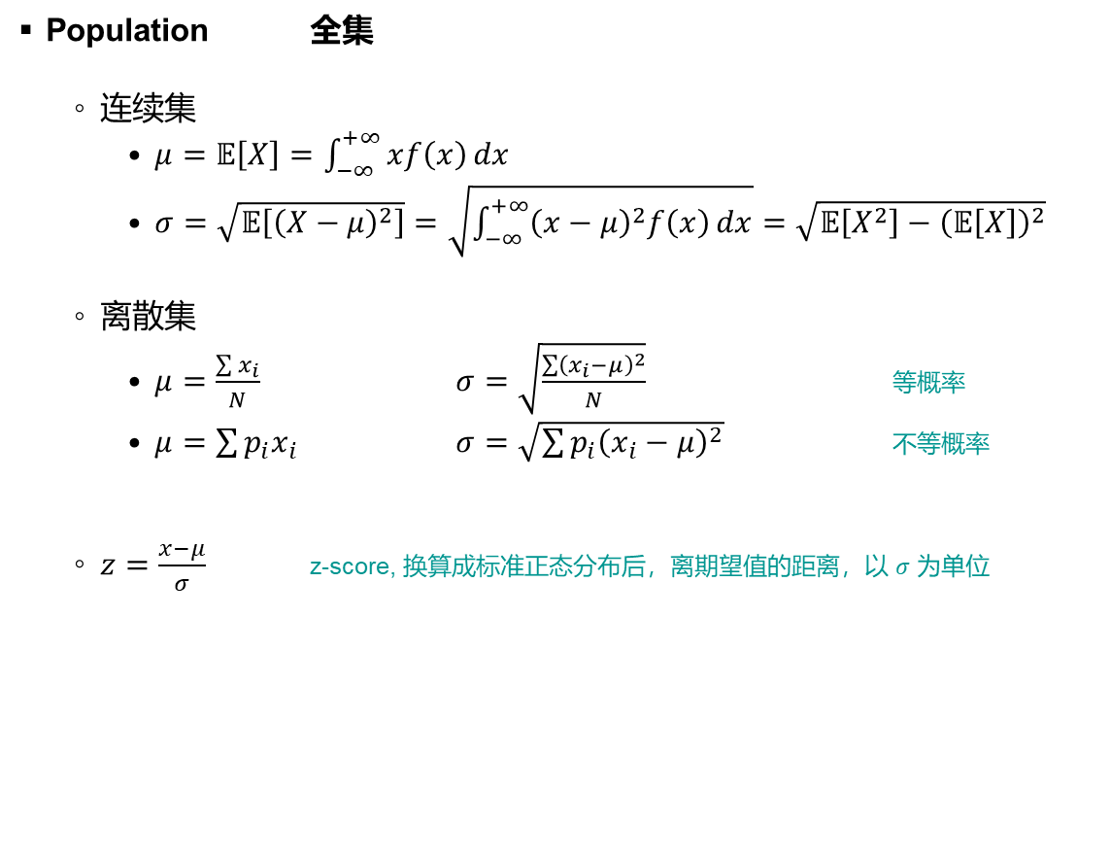
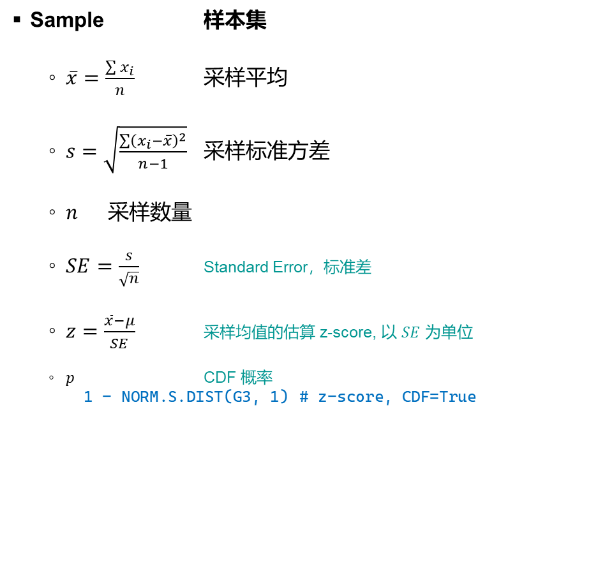
Terms
Sample 样本集
$\overline{x}=\frac{\sum{x_{i}}}{n}$ 采样平均
$s=\sqrt{\frac{\sum{{\left(x_{i}−\overline{x}\right)}^{2}}}{n−1}}$ 采样标准方差
$n$ 采样数量
$SE=\frac{s}{\sqrt{n}}$ Standard Error，标准差
$z=\frac{\overline{x}−μ}{SE}$ 采样均值的估算 z-score, 以 $SE$ 为单位
$p$ CDF 概率
1 - NORM.S.DIST(G3, 1) # z-score, CDF=True
Population 全集
连续集
$μ=𝔼\left[X\right]=\int_{−∞}^{+∞}{xf\left(x\right)}dx$
$σ=\sqrt{𝔼\left[{\left(X−μ\right)}^{2}\right]}=\sqrt{\int_{−∞}^{+∞}{{\left(x−μ\right)}^{2}f\left(x\right)}dx}=\sqrt{𝔼\left[X^{2}\right]−{\left(𝔼\left[X\right]\right)}^{2}}$
离散集
$μ=\frac{\sum{x_{i}}}{N}$ $σ=\sqrt{\frac{\sum{{\left(x_{i}−μ\right)}^{2}}}{N}}$ 等概率
$μ=\sum{p_{i}x_{i}}$ $σ=\sqrt{\sum{p_{i}{\left(x_{i}−μ\right)}^{2}}}$ 不等概率
$z=\frac{x−μ}{σ}$ z-score, 换算成标准正态分布后，离期望值的距离，以 $σ$ 为单位

Slide 20
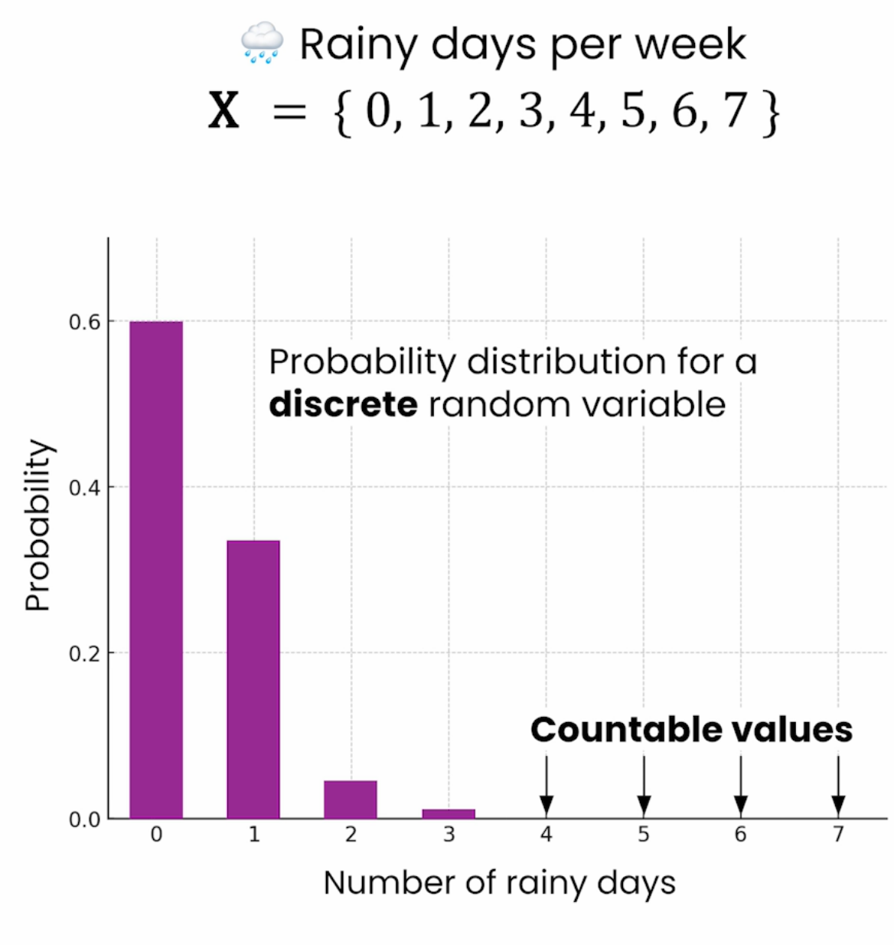
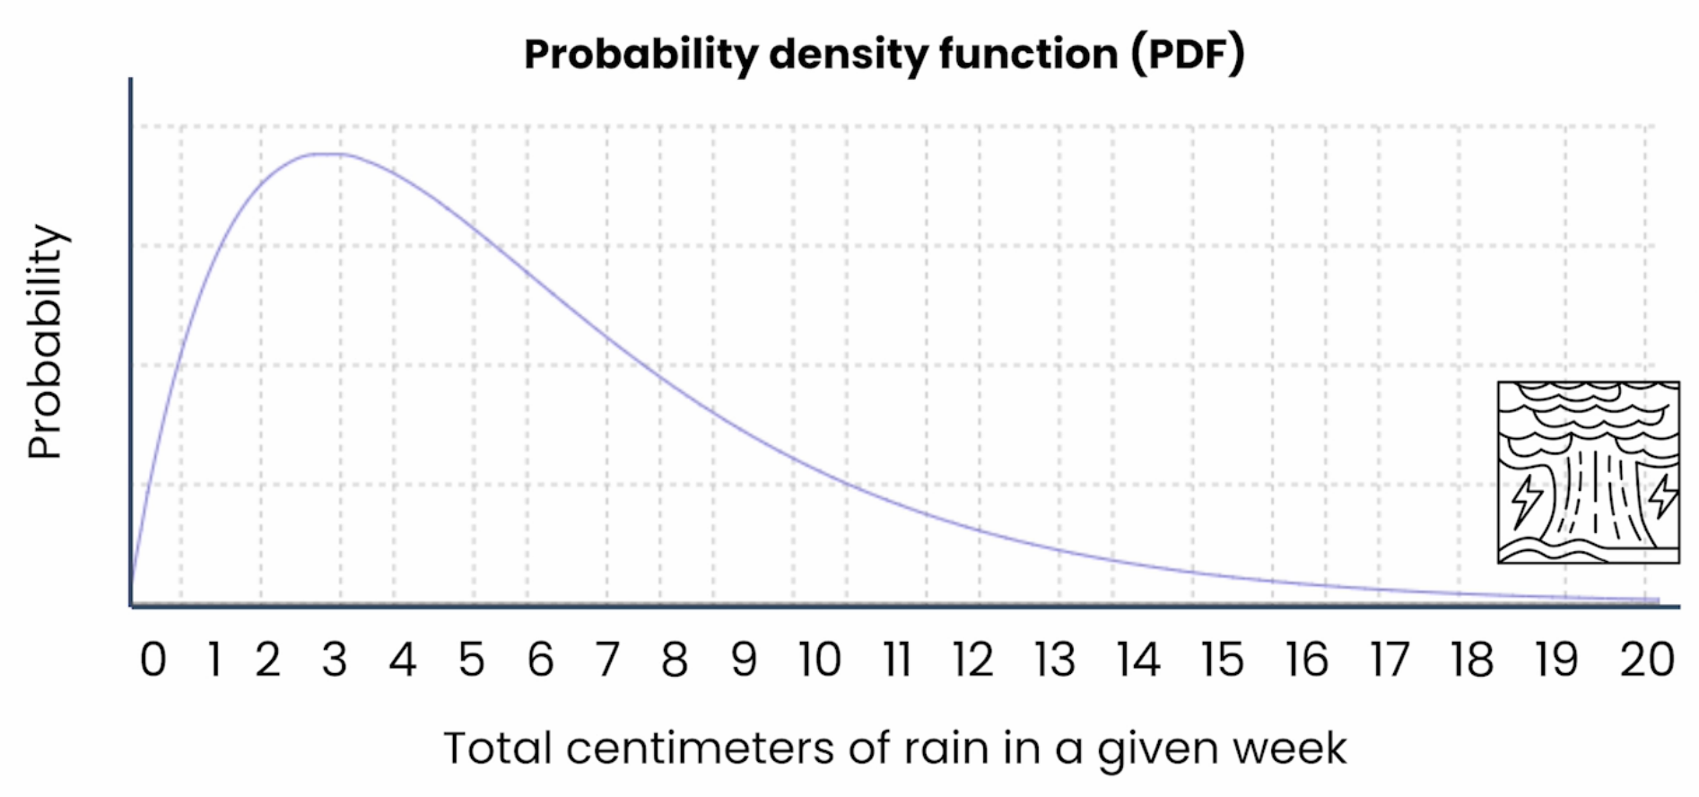
PMF vs. PDF
Probability Mass Function (PMF)
Probability Density Function (PDF)

Slide 21


分布
Bernoulli distribution
Mean $μ=P$
Variance $σ^{2}=P\left(1−P\right)$
Standard deviation $σ=\sqrt{P\left(1−P\right)}$
伯努利分布：互斥二值的事件
Binomial distribution
Mean $μ=nP$
Variance $σ^{2}=nP\left(1−P\right)$
Standard deviation $σ=\sqrt{nP\left(1−P\right)}$
二项分布：多个独立的伯努利事件

Slide 22
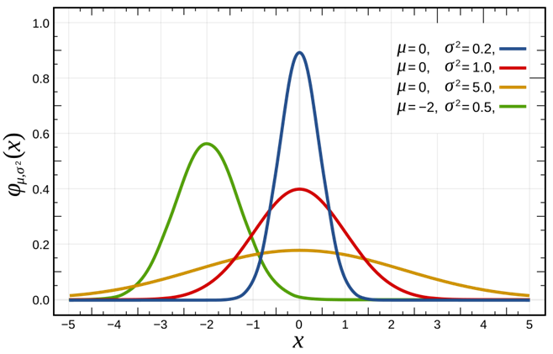
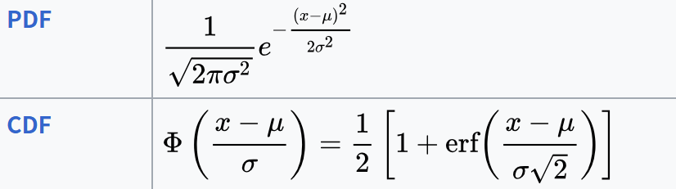
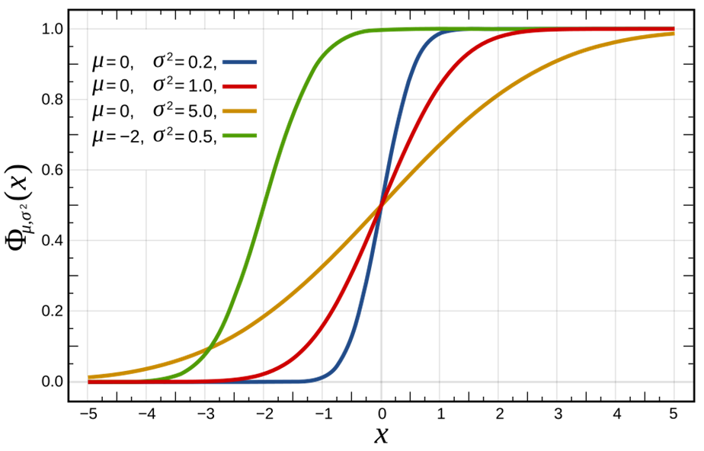
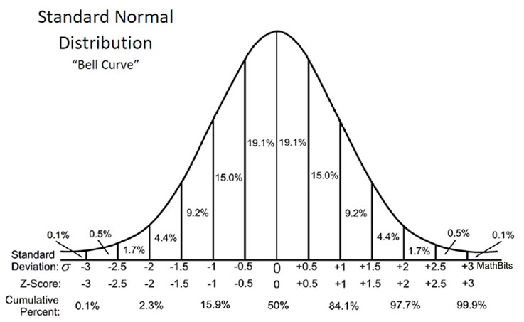

Normal distribution（正态分布）
PDF & CDF
z-score
$z=\frac{x−μ}{σ}$ 普通正态分布映射到标准正态分布，离开平均值的距离

Slide 23
Module 3
Confidence intervals

Slide 24

Descriptive vs. Inferential
Descriptive statistics
描述样本集（子集）的情况
Inferential statistics
通过样本集（子集），描述完整集（全集）的情况
一般会带有置信度（区间）
Standard Error (SE)
$=\frac{σ}{\sqrt{n}}$ $n$ 是实验次数
Sample proportion
$\hat{p}$ 样本比例

Slide 25
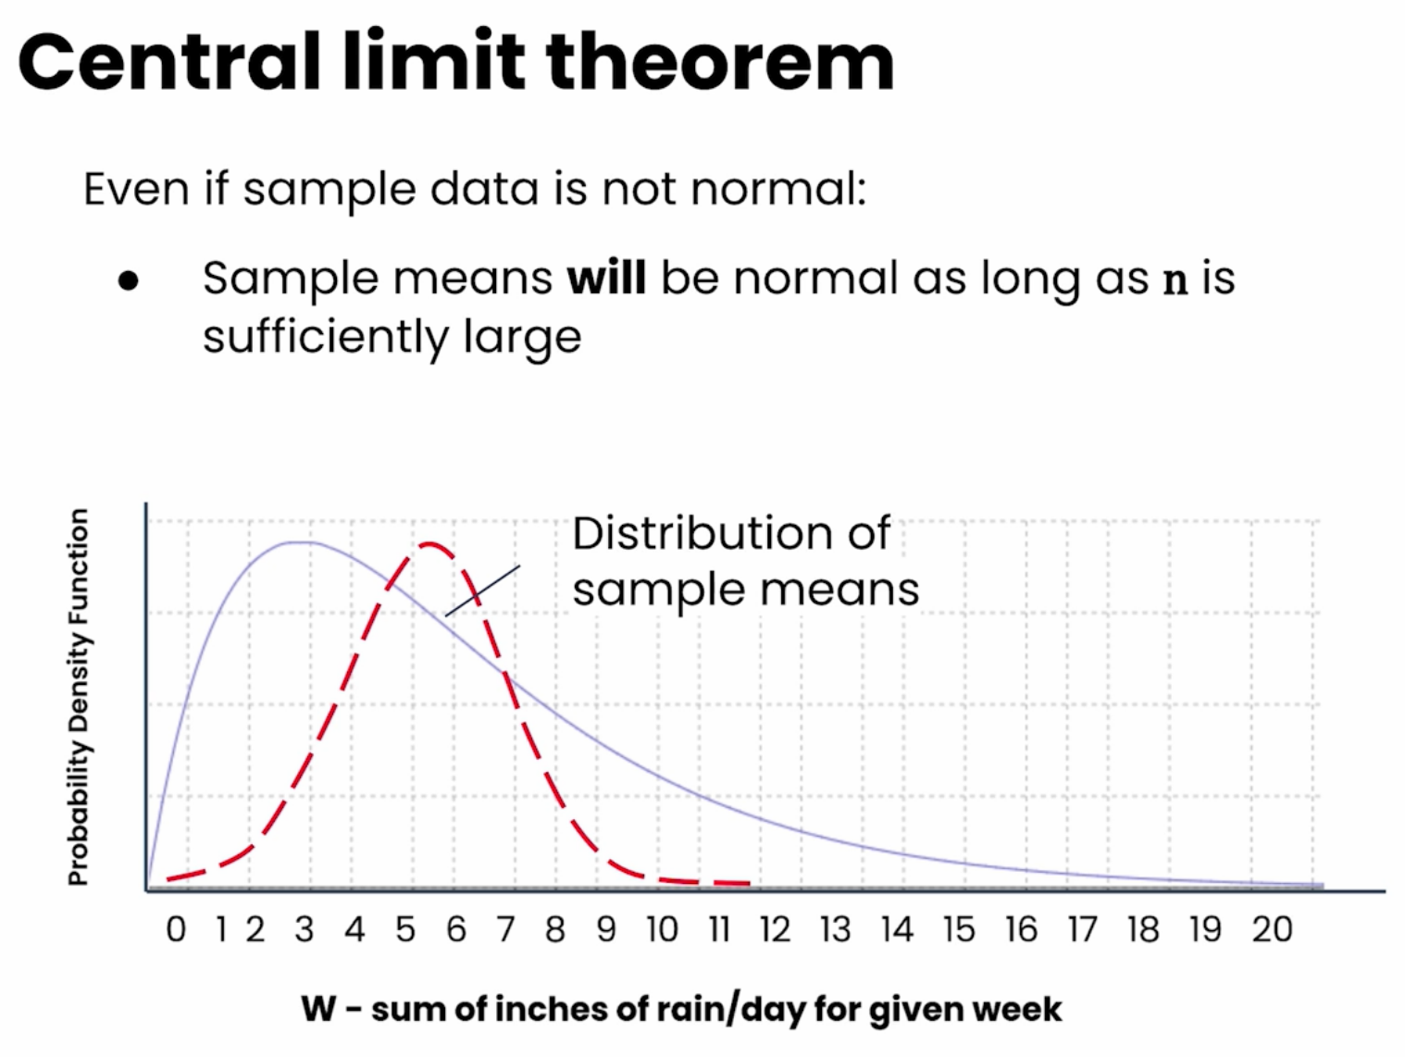
中心极限理论
采样平均永远是正态分布
就算底层的分布 PDF 不是正态分布的

Slide 26

总体均值的置信区间（Confidence interval for the population mean）
$\overline{x}±z×\left(\frac{s}{\sqrt{n}}\right)$ $z×\left(\frac{s}{\sqrt{n}}\right)$ 也称为 Margin Error
$\overline{x}$ 采样平均（采样批的统计平均，比如：平均用时）
$s$ 采样标准方差
$n$ 采样数量
$z$ z-score 标准正态分布
置信度为 97.7% 时，z-score=2
置信度为 95% 时，z-score=1.96
$2σ$ 下影面积为 95.4%
Confidence interval | z-score
90% | 1.645
95% | 1.96
99% | 2.576

Slide 27


总体特征的置信区间（Confidence interval for proportions）
$\hat{p}±z×\sqrt{\frac{\hat{p}\left(1−\hat{p}\right)}{n}}$
$\hat{p}$ 采样特征（采样批中的特征表现，比如：准点率）
$n$ 采样数量
$z$ z-score 标准正态分布
置信度为 97.7% 时，z-score=2
置信度为 95% 时，z-score=1.96
$2σ$ 下影面积为 95.4%
$z×\sqrt{\frac{\hat{p}\left(1−\hat{p}\right)}{n}}$ 也称为 Margin Error
$\sqrt{\frac{\hat{p}\left(1−\hat{p}\right)}{n}}$ 也称为 Standard Error
Confidence interval | z-score
90% | 1.645
95% | 1.96
99% | 2.576

Slide 28
Module 4
Hypothesis testing

Slide 29


Hypotheses
Null hypothesis $H_{0}$
Alternative hypothesis $H_{1}$
If find evidence for $H_{1}$ reject $H_{0}$
If no evidence for $H_{1}$ fail to reject $H_{0}$
例：
$H_{0}$ $μ=10$
$H_{1}$ $μ>10$
$z=\frac{\overline{x}−μ}{SE}$ 采样均值的估算 z-score, 以 $SE$ 为单位
$p=P\left(Z≤z\right)$ CDF 概率
=NORM.S.DIST(G3, 1)
# 计算 p, left tail: DIST($z$, CDF=True)
=Z.TEST(Data!M:M, 10)
# 计算 p: right tail, TEST(array, $H_{0}$, [$σ$])

Slide 30
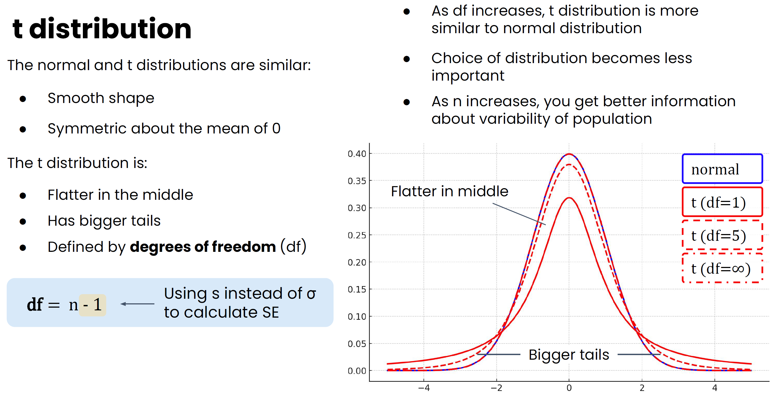

t-distribution
若
$n<30$ is common
$σ$ is rarely known
则
考虑使用 t-distribution（t.test），代替 normal-distribution（z.test）
注意：
t-distribution 只能用于 Hypothesis testing for mean，而不能用于 Hypothesis testing for proportion

Slide 31
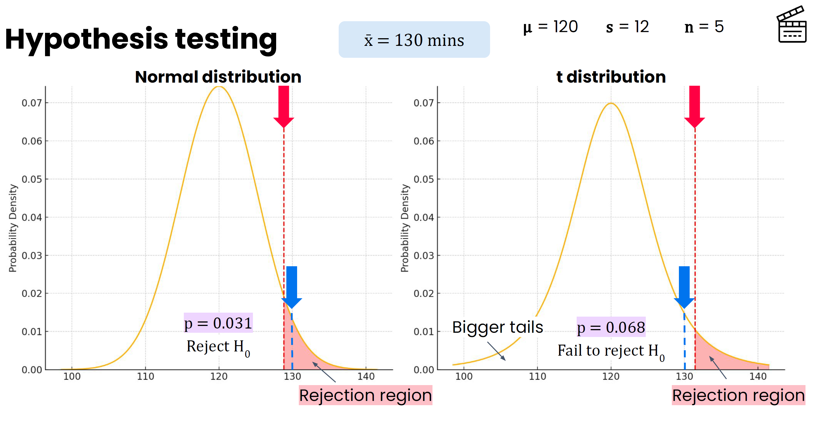
Hypothesis testing

Slide 32
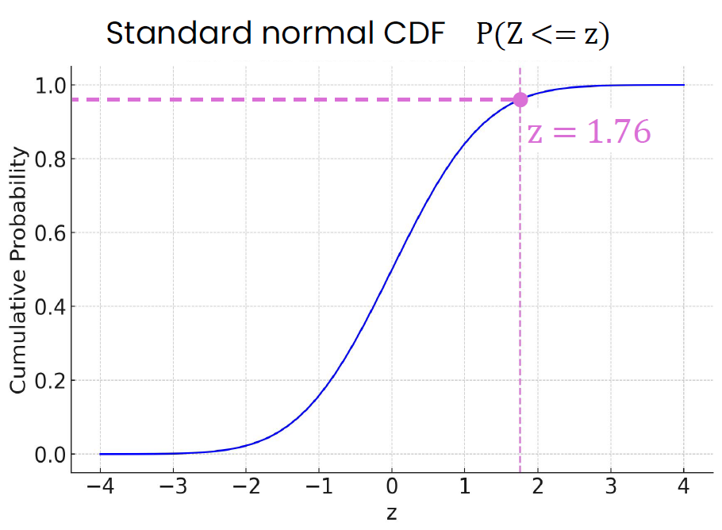
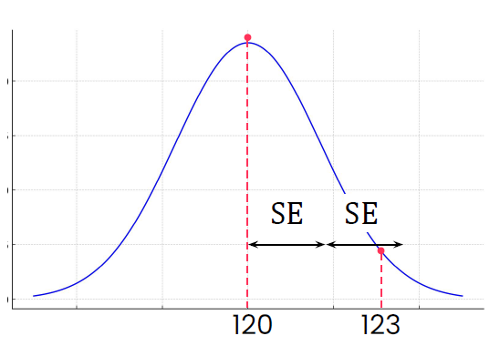
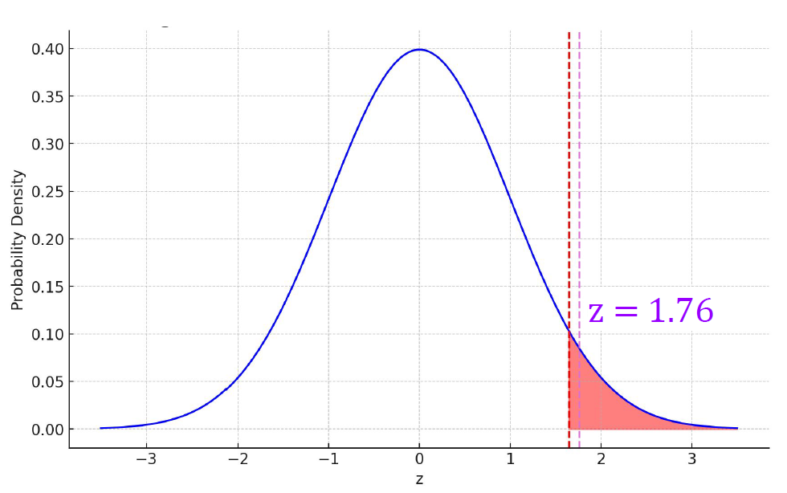
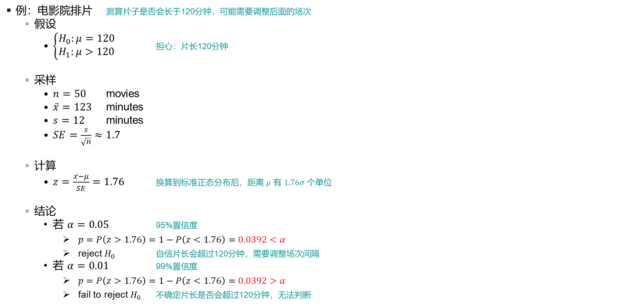
Hypothesis testing for mean
例：电影院排片 测算片子是否会长于120分钟，可能需要调整后面的场次
假设
$\left\{\begin{aligned}H_{0}:μ=120 \\ H_{1}:μ>120\end{aligned}\right.$ 担心：片长120分钟
采样
$n=50$ movies
$\overline{x}=123$ minutes
$s=12$ minutes
$SE=\frac{s}{\sqrt{n}}≈1.7$
计算
$z=\frac{\overline{x}−μ}{SE}=1.76$ 换算到标准正态分布后，距离 $μ$ 有 $1.76σ$ 个单位
结论
若 $α=0.05$ 95%置信度
$p=P\left(z>1.76\right)=1−P\left(z<1.76\right)=0.0392<α$
reject $H_{0}$ 自信片长会超过120分钟，需要调整场次间隔
若 $α=0.01$ 99%置信度
$p=P\left(z>1.76\right)=1−P\left(z<1.76\right)=0.0392>α$
fail to reject $H_{0}$ 不确定片长是否会超过120分钟，无法判断

Slide 33
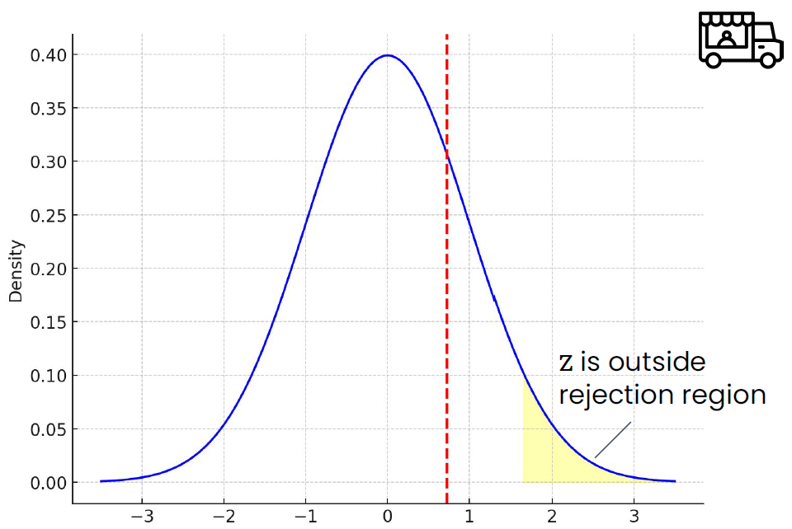
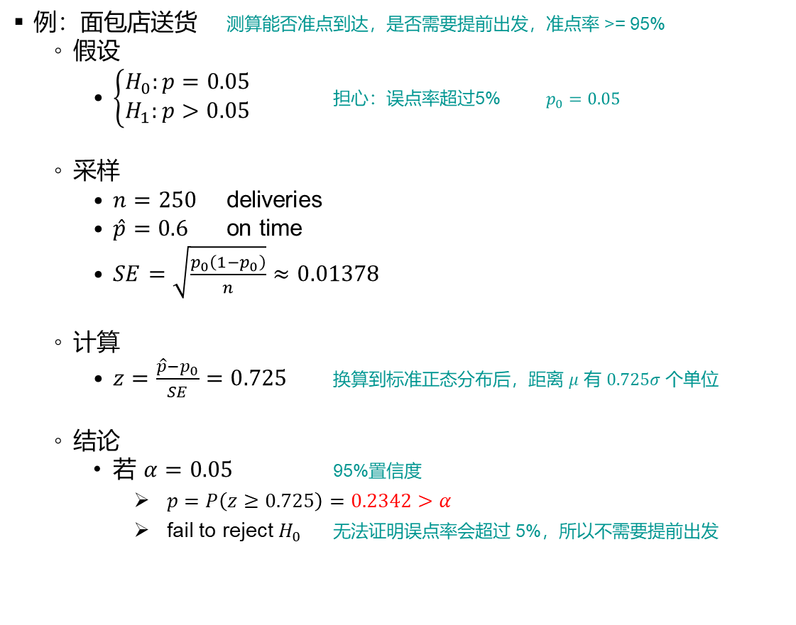
Hypothesis testing for proportion
例：面包店送货 测算能否准点到达，是否需要提前出发，准点率 >= 95%
假设
$\left\{\begin{aligned}H_{0}:p=0.05 \\ H_{1}:p>0.05\end{aligned}\right.$ 担心：误点率超过5% $p_{0}=0.05$
采样
$n=250$ deliveries
$\hat{p}=0.6$ on time
$SE=\sqrt{\frac{p_{0}\left(1−p_{0}\right)}{n}}≈0.01378$
计算
$z=\frac{\hat{p}−p_{0}}{SE}=0.725$ 换算到标准正态分布后，距离 $μ$ 有 $0.725σ$ 个单位
结论
若 $α=0.05$ 95%置信度
$p=P\left(z≥0.725\right)=0.2342>α$
fail to reject $H_{0}$ 无法证明误点率会超过 5%，所以不需要提前出发

Slide 34
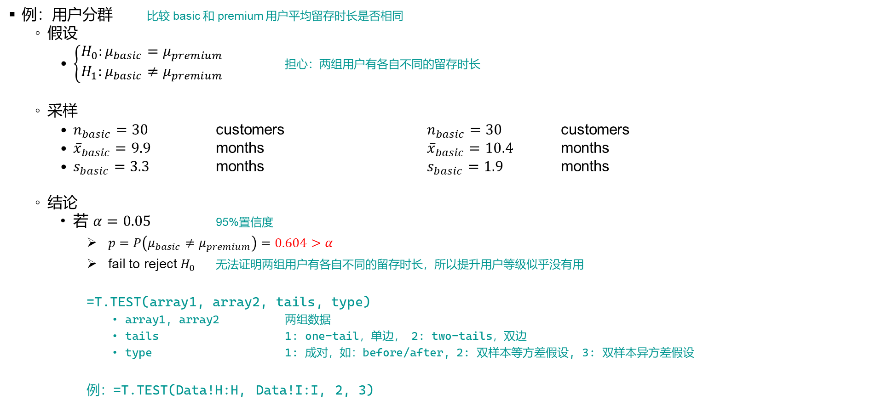
Two sample test
例：用户分群 比较 basic 和 premium 用户平均留存时长是否相同
假设
$\left\{\begin{aligned}H_{0}:μ_{basic}=μ_{premium} \\ H_{1}:μ_{basic}≠μ_{premium}\end{aligned}\right.$ 担心：两组用户有各自不同的留存时长
采样
$n_{basic}=30$ customers $n_{basic}=30$ customers
${\overline{x}}_{basic}=9.9$ months ${\overline{x}}_{basic}=10.4$ months
$s_{basic}=3.3$ months $s_{basic}=1.9$ months
结论
若 $α=0.05$ 95%置信度
$p=P\left(μ_{basic}≠μ_{premium}\right)=0.604>α$
fail to reject $H_{0}$ 无法证明两组用户有各自不同的留存时长，所以提升用户等级似乎没有用
=T.TEST(array1, array2, tails, type)
array1, array2 两组数据
tails 1: one-tail，单边， 2: two-tails，双边
type 1: 成对，如：before/after, 2: 双样本等方差假设, 3: 双样本异方差假设
例：=T.TEST(Data!H:H, Data!I:I, 2, 3)

Slide 35
Course 3
Python for Data Analytics

Slide 36
Module 1
Programming fundamentals for data analytics

Slide 37
Control flow
Conditional control flow
COUNTIF
SUMIF
AVERAGEIF
Repetitive control flow
ARRAYFORMULA

Slide 38
Module 2
Data structures and descriptive statistics

Slide 39
pandas
Read CSV
import pandas as pd
df = pd.read_csv(“survey_data.csv”)
data = pd.read_csv(“survey_data.csv”)
survey_data = pd.read_csv(“survey_data.csv”)
Dataframe
Attributes
df.columns
df.dtypes
Method
df.info()
Commands
sum()
max()
len()

Slide 40
pandas
Selecting columns
languages = df["LanguagesAtHome"]
columns = ["CountryOfResidence","LanguageAtHome"]
country_columns = df[columns]
Count, Sum, Histgrams
df.count()
df["Age"].count() # non-null
df["Income"].hist()
df["HoursSpentLearningToCode"].sum()
Sort
df.sort_values(by = "Age", ascending = True)
df_sorted_by_age = df.sort_values(by = "Age", ascending = True)

Slide 41
pandas
Filtering
df[ df["Gender"] == "female" ]
female_above_30 = df[(df['gender'] == 'female') & (df['age'] >= 30)]
female_or_above_30 = df[(df['gender'] == 'female') | (df['age'] >= 30)]
Selecting rows
indexed_df = df.set_index("ID")
indexed_df.loc[25447]
indexed_df.iloc[0]
indexed_df.iloc[1000:1006] # 算头不算尾
indexed_df.iloc[a:b]

Slide 42
pandas
Central tendency, variability, and skewness
hours.describe()
count 14942.000000
mean 15.323317
median 10.00000
std 14.274867
min 0.000000
25% 5.000000
50% 10.000000
75% 20.000000
max 100.000000
.mean() .median()
.skew()
.max() .min()
.std() .var()
.quantile()
hours.quantile(0.5)
hours.quantile([0.25, 0.5, 0.75])
Categorical data
df["Gender"].value_counts()
Gender
male 10766
female 2840
genderqueer 66
agender 38
trans 36
counts_of_gender = df["Gender"].value_counts()
counts_of_gender.plot(kind="bar")
Correlation
selected_columns = df[columns]
selected_columns.corr()

Slide 43
pandas
Segmentation by one feature
df.groupby("NumberofChildren")
df.groupby("NumberofChildren")["HoursSpentLearningToCode"]
df.groupby("NumberofChildren")["HoursSpentLearningToCode"].count()
Segmentation by multiple features
df.pivot_table(index = "NumberOfChildren",
columns = "IsSoftwareDev",
values = "HoursSpentLearningToCode",
aggfunc = "sum" # ...aggfunc = ["min", "median", "max"])
)

Slide 44
Module 3
Visualization

Slide 45
Matplotlib
Plot pandas data
df["grade"].value_counts().sort_index()
import matplotlib.pyplot as plt
sorted_grades.plot(kind="bar")
plt.xlabel("")
plt.ylabel("Frequency")
plt.title("Frequency of Loan by Grade")
plt.show():
Colors, grids, & saving plots
sorted_grades.plot(kind="bar", color="purple") # "8af133"
colors = ["Green", "Lime", … , "Red"] # bar colors
sorted_grades.plot(kind="bar", color=colors)
plt.grid(axis="y", color="black", alpha=0.7, linestyle="--") # add grid lines
plt.savefig("loan_column_chart.png") # save an image

Slide 46
Matplotlib
Ticks & spines
plt.xticks(rotation=0) # rotate x axis labels
ax = sorted_grades.plot(kind="bar", color=colors)
ax.yaxis.set_minor_locator(AutoMinorLocator(2)) # add more ticks
ax.spines["left"].set_visible(False) # remove the spines
Grouped column charts
states = ["DC", "AK", "HI"] # names of top 3 states
filtered_df = df[df["state"].isin(states)] # select rows
grouped_df = filtered_df.groupby(["state", "grade"]) # grouped by 2 features
grouped_loan_amount = grouped_df["loan_amount"].mean() # calculate mean of each group
Stacked column chart
grouped_df.plot(kind = "bar", stacked = True,
color=["lightgray", "darkgray", "mediumseagreen"])
proportion_df = grouped_df.div(grouped_df.sum(axis=1), axis=0)
proportion_df.plot(kind = "bar", stacked = True,
color=["lightgray", "darkgray", "mediumseagreen"])

Slide 47
Matplotlib
Scatter plots
plt.scatter(df["annual_income"], df["total_credit_limit"],
alpha=0.5 , marker=".", color="darkgreen")
plt.xlim(0, 500000)
plt.ylim(...)
plt.axvline(x=top_5_percent_income, color="black", linestyle="--")
plt.axhline(...)
Method chaining
grouped_data = df.groupby(["grade", "homeownership"])
grouped_data_loan_amount = grouped_data["loan_amount"]
grouped_sum_of_loans = grouped_data_loan_amount.sum()
unstacked_sum_of_loans = grouped_sum_of_loans.unstack()
unstacked_sum_of_loans.plot(kind="bar", stacked=True)

Slide 48
Seaborn
Plotting with Seaborn
import seaborn
sns.barplot()
sns.lineplot()
sns.regplot()
sns.boxplot(selected_stocks, estimator = np.mean)
np.max
np.size
np.std
Themes & palettes
sns.set_theme(style = "white")
sns.barplot(...palette = "Blues")
sns.barplot(...palette ="RdYlGn_r")

Slide 49
Seaborn
Box plots
sns.boxplot(df, x = "interest_rate") # or y = "interest_rate"
sns.boxplot(df, x = "grade" , y = "interest_rate")
sns.despine(left = True, bottom = True)
plt.figure(figsize = (8, 6))
Histograms
sns.histplot(df, x = "grade" , binwidth = 50 , kde = True)
# or y = "interest_rate"
# or bins = 10
sns.set_style("ticks")

Slide 50
Matplotlib subplots
Matplotlib subplots
plt.figure(figsize = (5,5))
plt.subplot( 2, 3, 4 )
sns.barplot(filtered_df, hue="grade", y="paid_interest", palette="RdYlGn_r")
Looping with subplots
plt.figure(figsize=(15,15))
for i in range(1,10):
plt.subplot(3, 3, i)
filtered_df = df[df["open_credit_lines"] == i]
sns.barplot( filtered_df, hue="grade", y="paid_interest", palette="RdYlGn_r")
plt.title(i)
plt.savefig("9graphs.png")

Slide 51
Seaborn pairplot
Seaborn pairplot
sns.pairplot(df[["loan_amount", "annual_income", "interest_rate", "paid_interest"]])
plt.suptitle("Pairplot of Loan Amount, Annual Income, Interest Rate, and Paid Interest")

Slide 52
Module 4
Inferential Statistics

Slide 53
Inferential statistics
Confidence intervals
n = df["price"].count() # Sample size
xbar = df["price"].mean() # Mean
s = df["price"].std() # Standard deviation
SEM = s / np.sqrt(n)
interval = stats.norm.interval(confidence=conf, loc=xbar, scale=SEM)
One-sample t-tests
test_results = stats.ttest_1samp(df[df["cut"] == "Premium"]["price"] , popmean = 4500)
p_value = test_results[1]
Two-sample t-tests
test_results = stats.ttest_ind(good_prices, very_good_prices)
p_value = test_results[1]

Slide 54
Inferential statistics
Simulation
sample = np.random.uniform(low = 0, high = 0.1, size = n)
interval = stats.norm.interval(confidence = conf, loc = xbar, scale = SEM)
Simulation: normal
samples = np.random.normal(loc = 3932, scale = 750, size = 1000)
samples = np.random.uniform(low = some_value, high = some_other_value, size = n)

Slide 55
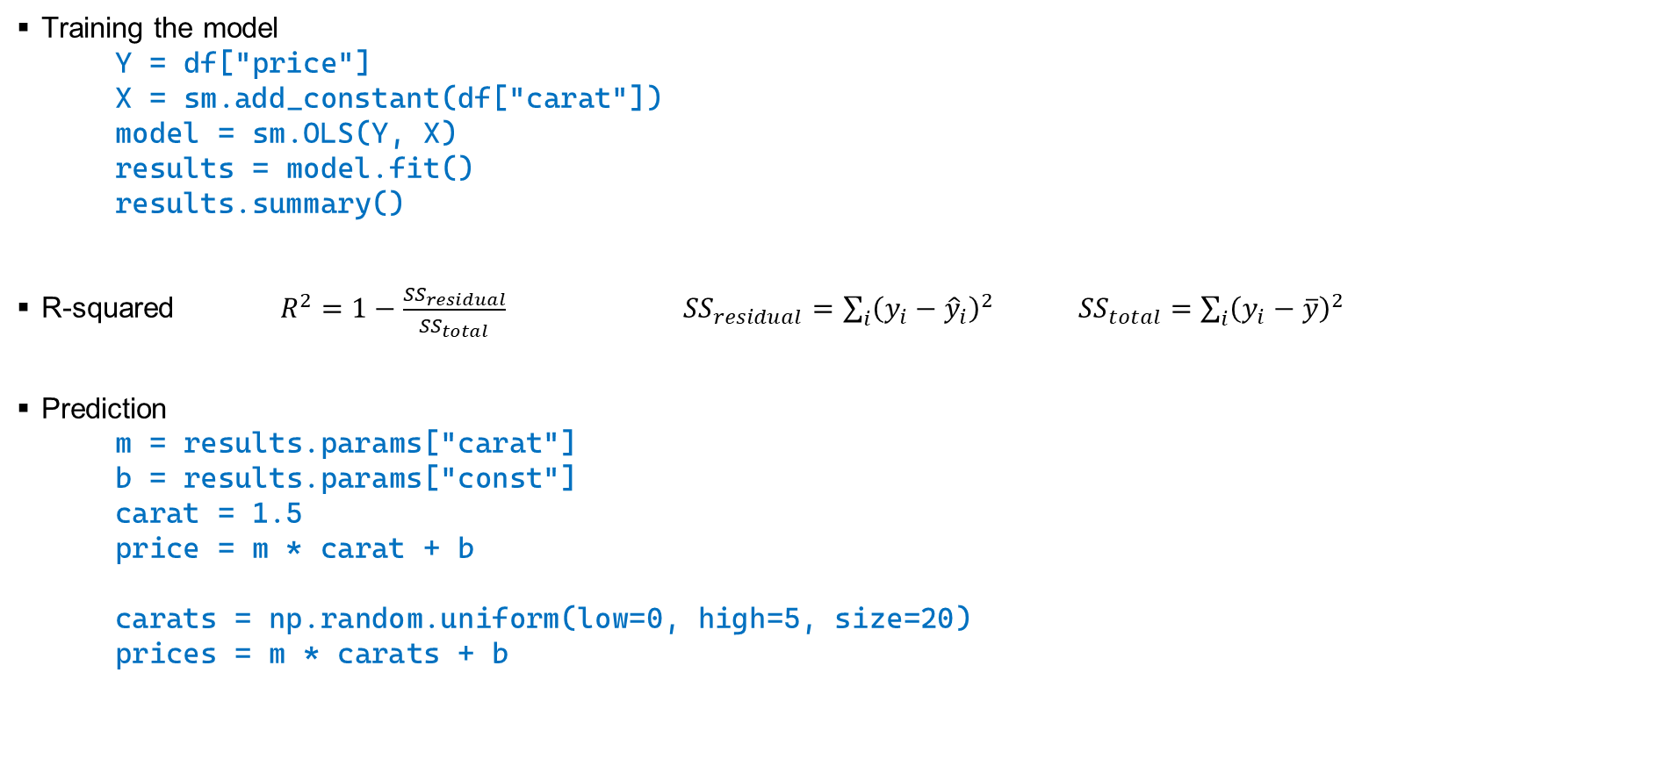
Inferential statistics
Training the model
Y = df["price"]
X = sm.add_constant(df["carat"])
model = sm.OLS(Y, X)
results = model.fit()
results.summary()
R-squared $R^{2}=1−\frac{{SS}_{residual}}{{SS}_{total}}$ ${SS}_{residual}=\sum_{i}{{\left(y_{i}−{\hat{y}}_{i}\right)}^{2}}$ ${SS}_{total}=\sum_{i}{{\left(y_{i}−\overline{y}\right)}^{2}}$
Prediction
m = results.params["carat"]
b = results.params["const"]
carat = 1.5
price = m * carat + b
carats = np.random.uniform(low=0, high=5, size=20)
prices = m * carats + b

Slide 56
Inferential statistics
Multiple linear regression model
predictors = ["carat","x","y","z"]
Y = df["price"]
X = sm.add_constant(df[predictors])
model = sm.OLS(Y, X)
results = model.fit()
m1 = results.params["carat"]
m2 = results.params["x"]
m3 = results.params["y"]
m4 = results.params["z"]
b = results.params["const"]
Encoding categorical data
pd.get_dummies(df[predictors], columns=["color"], drop_first=True, dtype=int)
Categorical data
X_test = X[:1000] # for testing
Y_test = Y[:1000] # for testing
X_train = X[1000:] # for training
Y_train = Y[1000:] # for training

Slide 57
Inferential statistics
Multiple linear regression
predicted = results.predict(diamond1) # 一个样本点
predicted = results.predict(X_test) # 一组样本点

Slide 58
Module 5
Time series

Slide 59
Time series & forecasting
DateTime
date = pd.to_datetime("2035-02-17")
date.weekday()
df["date"].dt.day
DataTimes as indices
apple_stocks.set_index("datetime")
apple_stocks.set_index("datetime", inplace = True)
apple_stocks.loc["2024-03-01"]
apple_stocks.loc["2024-03-01":"2024-03-31"] # 带头也带尾
date.month
date.day
date.year
date.quarter

Slide 60
Time series & forecasting
Line charts
sns.lineplot(apple_stocks_feb_2020["adjusted_close"])
sns.lineplot(x = apple_stocks_feb_2020.index.day,
y = apple_stocks_feb_2020["adjusted_close"],
color = "darkgray")
sns.lineplot(x = apple_stocks_feb_2020.index.day,
y = apple_stocks_feb_2020["adjusted_close"],
color = "darkgray",
label = "February 2020")
Formatting date axis labels
import matplotlib.dates
ax.xaxis.set_major_locator()
ax.xaxis.set_major_formatter()
Date format codes:
● %y → Year without century ('24)
● %Y → Full year (2024)
● %m → Zero-padded month (02)
● %d → Day (26)
● %b → Abbreviated month (Feb)
Combine together:
● %m %y → 02 24 (Month & Year)

Slide 61
Time series & forecasting
Moving average
df["Volume"].rolling(window=14).mean()
df["Volume"].rolling(window=14).median()
sns.lineplot(amazon_volume_14day, color="black")
Percent change
amazon_close_pct_change = amazon_stocks["adjusted_close"].pct_change()
sns.lineplot(amazon_close_pct_change, color = "#FF9900")
dips = amazon_close_pct_change[amazon_close_pct_change < -0.05]
Segmentation
netflix_stocks.index.year
netflix_stocks["quarter"] = netflix_stocks.index.quarter
monthly_volume = netflix_stocks.groupby("month")["volume"].mean()

Slide 62
Time series & forecasting
Multiple line charts - reshaping
tickers = ["AAPL", "AMZN"]
selected_stocks = df[df["ticker"].isin(tickers)]
pivoted_stocks = selected_stocks.pivot(index = "datetime",
columns = "ticker",
value = "adjusted_close")
sns.lineplot(pivoted_stocks)
Resampling
nike_stocks.resample("W")
nike_weekly = numeric_data.resample("ME").mean()
nike_weekly = numeric_data.resample("W").first()
To downsample your data:
○ "W" - Weekly
○ "D" - Daily
○ "ME" - Month End
○ "W-MON" - Weekly on Monday

Slide 63
Time series & forecasting
Seasonality
week210 = [1, 210, 0, 0, 1]
results.predict(week210)
week210 = [1, 210, 0, 1, 0]
results.predict(week210)
Error metrics
residuals = y_actual - y_pred
MAE = residuals.mean().abs()

Slide 64
Course 4
Data I/O and Preprocessing with Python and SQL

Slide 65
Module 1
Web scraping & text preprocessing

Slide 66
Web scraping & text preprocessing
Scraping tables
tables = pd.read_html("http://www.domain.com/")
df = tables[0]
df.head()
df.info()
Replace
df["Change %"].str.replace("%","")
df["date"].dt.year
df["date"].dt.month
Casting
date = pd.to_datetime("2030-12-31")
day_of_week = date.weekday()
print(day_of_week) # Tuesday
df["Change %"].astype("float")
df["Change %"].astype("Float64")

Slide 67
Web scraping & text preprocessing
Handling missing data
df.dropna(subset=["Dog Population"])
df["Dog Population"].fillna()
Contains
df["Official Language"].str.contains("English", case = False)
String processing
df["Country"].str.split("[").str[0].str.strip()

Slide 68
Web scraping & text preprocessing
Networking
pd.read_html("https://dlai-lc-dag.s3.useast-2.amazonaws.com/countries_and_pet_population.html")
Requests
import requests
url = "http://www.seasky.org/astronomy/astronomy-calendar-2030.html"
response = requests.get(url)
response.status_code
response.content
Beautiful Soup
soup.find_all("li", class_ = True)
for event in soup.find_all("li", class_ = True):
date = soup.find("span", class_ = "date-text").text
event_list.append([date, title, description])
df = pd.DataFrame(event_list)

Slide 69
Web scraping & text preprocessing
DataFrame setup
df.columns = ["date", "title", "description"]
df["title"] = df["title"].str.replace(".", "", regex=False)
df["date"] = df["date"].str.split(",").str[0]
df["description"] = df["description"].str.split(".", n=1).str[1]
def convert_datetime_column(dataframe, column_name, year):
if not pd.api.types.is_datetime64_any_dtype(dataframe[column_name]):
dataframe[column_name] = dataframe[column_name] + f" {year}"
dataframe[column_name] = pd.to_datetime(dataframe[column_name], format='%B %d %Y')
return dataframe
df = convert_datetime_column(df, "date", 2030)
Regex and string methods
pattern = r"\d{3}-\d{3}-\d{4}"
df["message"].str.extract(pattern) # str.contains(), str.replace(), str.extract()

Slide 70
Web scraping & text preprocessing
Server load and resource use
import time
for page in pages_to_scrape:
scrape_page(page)
time.sleep(1)

Slide 71
Module 2
APIs & numerical cleaning

Slide 72
APIs & Numerical Cleaning
JSON
{
"name" : "Andromeda Galaxy",
"distance_lightyears" : 2537000,
"visible_from_earth" : true,
"neighboring_galaxies" : [ "Triangulum Galaxy", "Milky Way" ]
}
data["results"][0]["product_quantity"]
API requests and responses
import requests
import pandas as pd
url = "https://api.fda.gov/food/enforcement.json"
response = requests.get(url)
print(response.status_code)
data = response.json()

Slide 73
APIs & Numerical Cleaning
Query parameters
https://api.fda.gov/food/enforcement.json?search=distribution_pattern:"nationwide"&limit=5
params = {...}
requests.get(url, params = params)
JSON to a dataframe
pd.DataFrame(data["results"])
Pagination
for i in range(25):
params = {
"limit": 1000,
"skip": i * 1000,
}
data = requests.get(url, params=params).json()
dfs.append(pd.DataFrame(data["results"]))
df = pd.concat(dfs, ignore_index = True )

Slide 74
APIs & Numerical Cleaning
Using an API key
params = {"api_key": api_key}
url = "https://2eraiuh.dlai.link/api/facilities"
response = requests.get(url, params=params)
Environment variables
import os
from dotenv import load_dotenv
# Load the .env file
load_dotenv(".env")
# Retrieve the API key
api_key = os.getenv("FOOD_SAFETY_API_KEY")

Slide 75
APIs & Numerical Cleaning
Scaling
df["scaled_violations"] = df["total_violations"] / df["square_footage"]
df["scaled_violations"] = df["scaled_violations"] * 100000
df["scaled_violations"] = round(df["scaled_violations"], 2)
Binning
pd.qcut( df['production_volume'], q=3, labels=['Low', 'Moderate', 'High'])
boundaries = [0, 75, 90, 100]
pd.cut( df['employee_count'], bins=boundaries, labels=['Low', 'Medium', 'High'])
Normalization
df["days_normalized"] = 1 - normalize(df["days_since_last_inspection"])
df["violations_normalized"] = 1 - normalize(df["violations_per_1000_sqft"])
df["composite_score"] = round( (df["days_normalized"] * 0.30 +
df["violations_normalized"] * 0.50 * 100)

Slide 76
Module 3
Databases

Slide 77
SQL
SQL query
SELECT order_id, total_amount
FROM orders
ORDER BY total_amount DESC
LIMIT 10;

Slide 78
SQL
Selecting
SELECT name, milliseconds, unitprice
FROM tracks;
SELECT name, milliseconds, unitprice
FROM tracks
LIMIT 10;
SELECT *
FROM tracks
LIMIT 10;
Ordering results
SELECT name, milliseconds, bytes
FROM tracks
ORDER BY bytes;
SELECT name, milliseconds, bytes, genreid
FROM tracks
ORDER BY genreid, bytes DESC;
SELECT name AS track_title
FROM tracks
ORDER BY genreid, bytes DESC;

Slide 79
SQL
SQL in Python
import sqlite3
connection = sqlite3.connect("music.db")
query = "SELECT * FROM artists;"
query = """
SELECT name, milliseconds, bytes, genreid
FROM tracks
ORDER BY genreid, bytes DESC;
"""
results = pd.read_sql_query(query, connection)

Slide 80
Module 4
Preprocessing, validation, and joins with SQL

Slide 82
Course 5
Data Storytelling

Slide 83
Module 1
Data storytelling fundamentals

Slide 85
Module 2
Creating charts with Tableau

Slide 87
Module 3
Creating dashboards & stories with Tableau

Slide 89
Module 4
The Job Search

